Slide 1
dzAlerts provide high quality, and detailed alerts on performance regressions https://wiki.mozilla.org/Auto-tools/Projects/Alerts

Slide 2

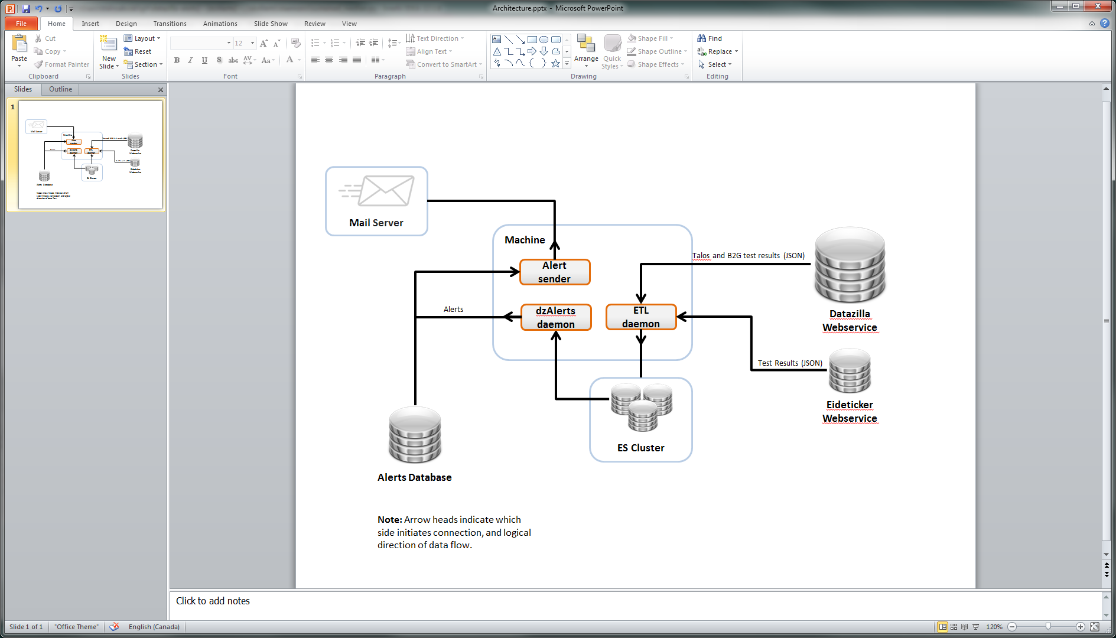
Architecture
ETL into ElasticSearch document store
Analyze time series
Send alerts

Slide 3
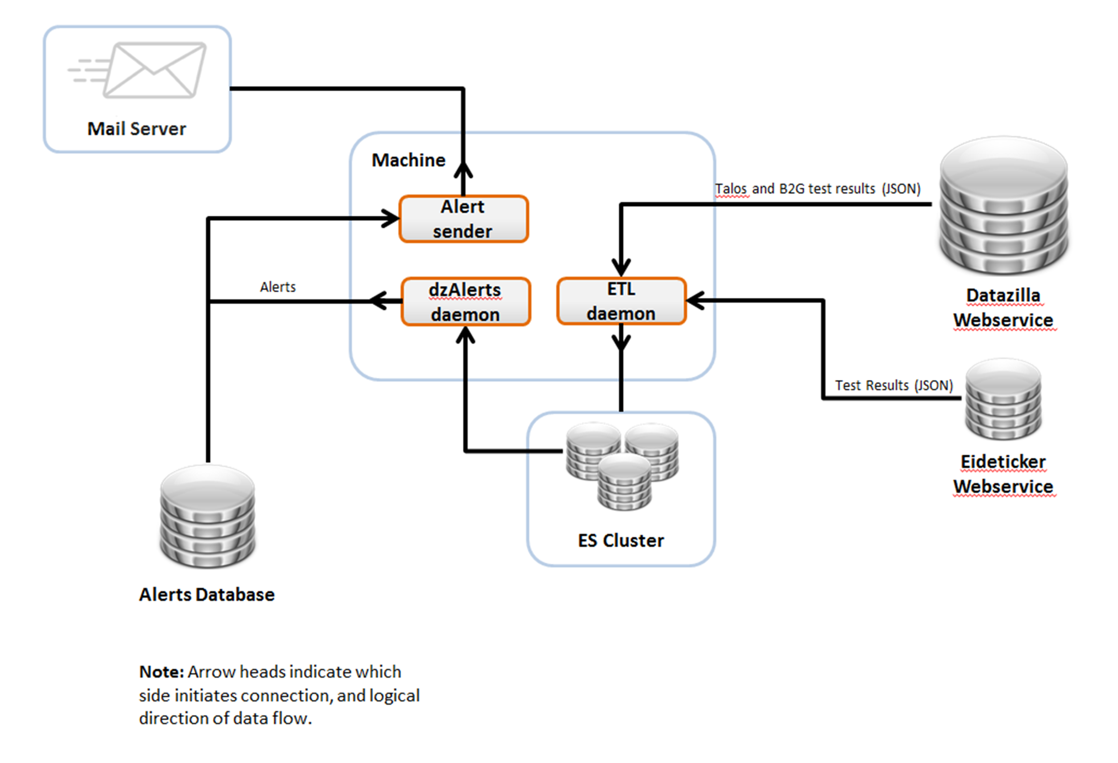
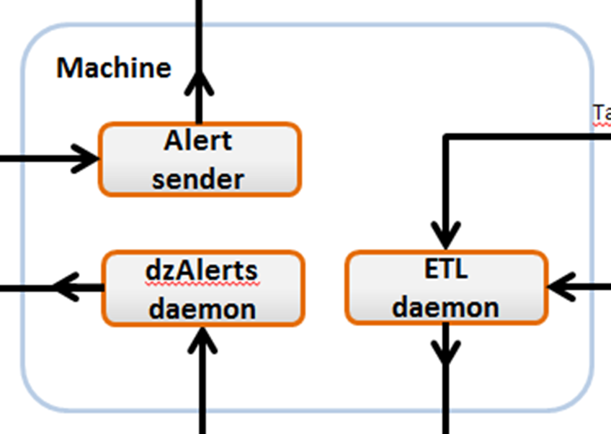
Architecture
ETL into ElasticSearch document store
Analyze time series
Send alerts

Slide 4
Architecture
ETL into ElasticSearch document store
Analyze time series
Send alerts
Extract ~40 test results per second from Datazilla (whole suites)
Transform test suite results into individual test results
Load into ElasticSearch
Notes:
Create index if not exists
Search ES for what IDS to pull next (previous request timeouts, json not processed yet, general errors)
Fill file cache/use file cache for faster reloading (also gives us flat record of all test results)
Multithreaded for multiple requests
Pull pushlog from Datazilla database
Add datazilla metadata to test result record
Transform [name, count] array pairs to {name: count} properties
Add pushlog date, if exists
Split dromaeo sub-test results
Add precomputed statistics
Separate thread to load ES

Slide 5
Architecture
ETL into ElasticSearch document store
Analyze time series
Send alerts
Daemon is run every 10min, and has significant startup/shutdown times:
~60 seconds to load (determine which tests to analyze)
~1.7 time series per second (~50 stats each, but does not matter)
~30 seconds to write alerts to database
Works out to about 10 test suites per minute
Notes:
Probe ES for domain of each dimension (look for new tests, branches and architectures)
Determine which combination of test, os, branch, hardware (naïve 2million different combinations),
Test/Suite/Branch specific parameters
Run a variety of window functions for humane time window, past revision, past stats, future stats, and diff
Reanalyze as more data arrives
Compare to existing alerts: change and obsolete as needed
Merge alerts on same revision

Slide 6
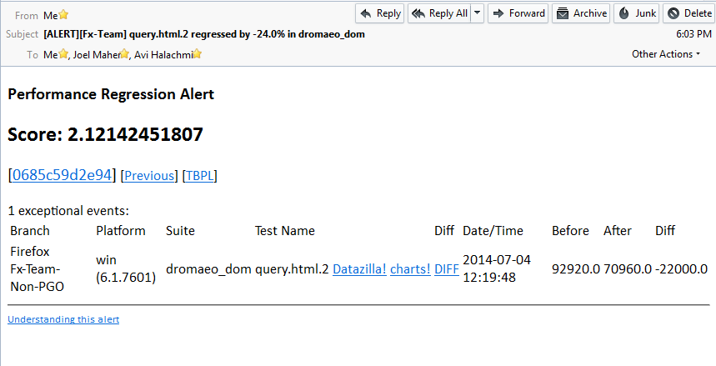
Architecture
ETL into ElasticSearch document store
Analyze time series
Send alerts
Notes:
Track which alerts have been sent

Slide 7
Mail
Send alerts

Slide 8
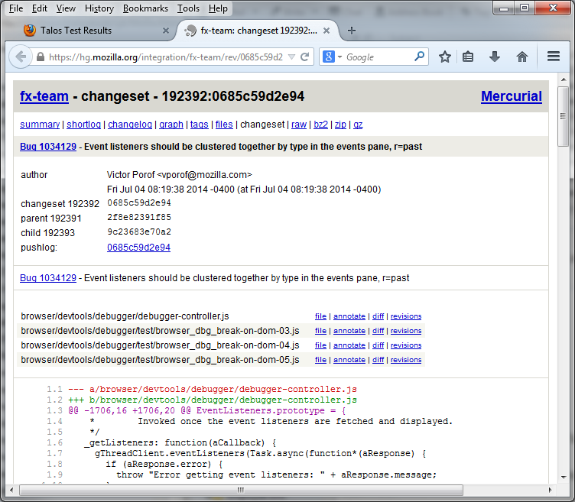
Mail
Mercurial

Slide 9
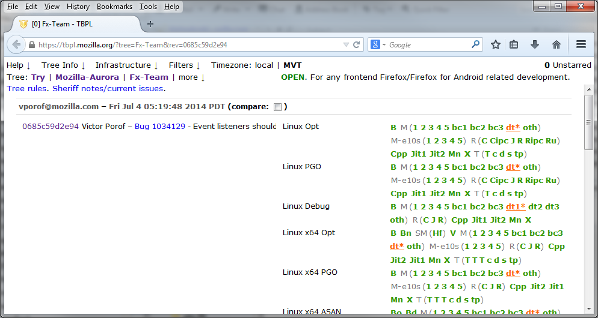
Mail
TBPL

Slide 10
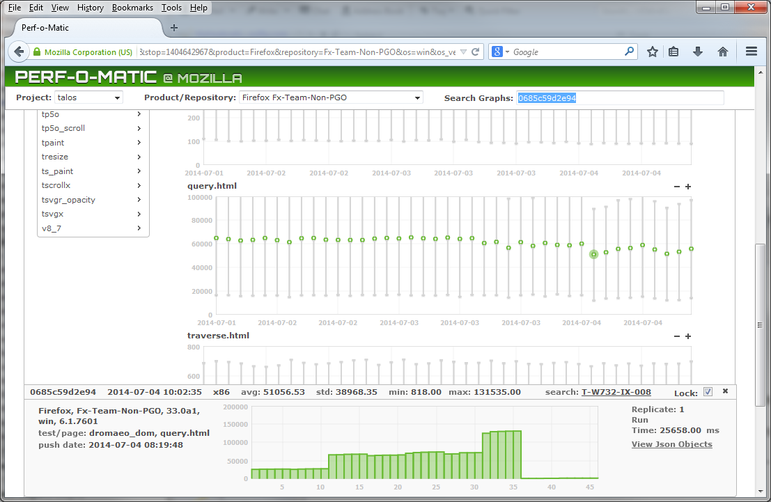
Mail
Datazilla

Slide 11
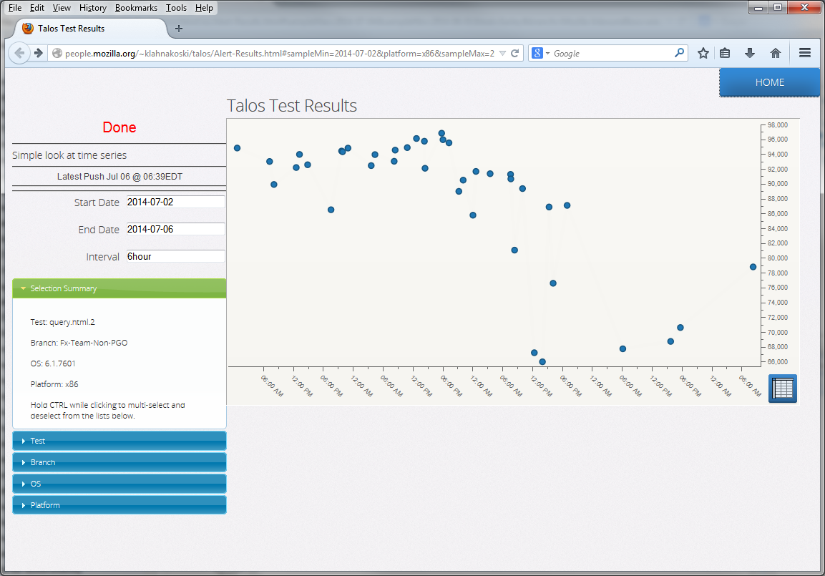
Mail
Simple Chart Tool
Notes:
Necessary to view sub-test results
Faster to view series
Very limited

Slide 12
Debugging
Notes:
Something more interesting to show

Slide 13
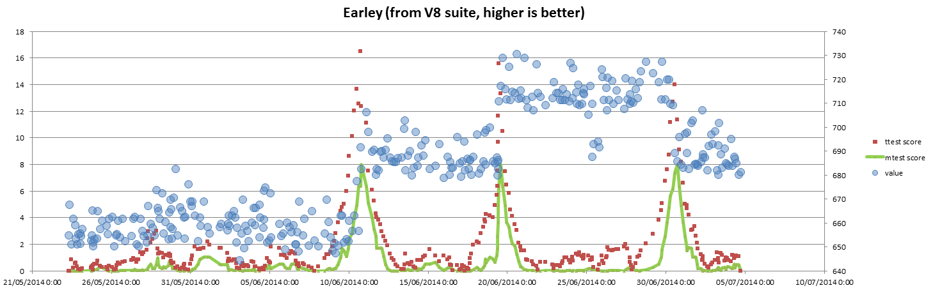
Debugging
Always chart your data points
Visualize algorithm’s statistics to get a feel for what it sees
Bugs are not usually in the math
Notes:
Blue circles are test results (scale on right)
Scores are –log10(p-value) for clarity

Slide 14
Debugging
Regression!? Where’s my alert?

Slide 15
Debugging
Past mean
Future Mean
Difference
717
689
28 (3.9%)
mean=717
mean=689

Slide 16
Debugging
Past mean
Future Mean
Difference
Threshold
717
689
28 (3.9%)
36 (5.0%)
mean=717
mean=689

Slide 17
Debugging
Problems usually with
Setting thresholds
Dealing with settings
Managing alert life cycle
mean=717
mean=689

Slide 18
Debugging
Problems usually with
Setting thresholds
Dealing with settings
Managing alert life cycle
Programming is hard
mean=717
mean=689

Slide 19
Post Mortem

Slide 20

Talos is Big!
From May 20th to July 5th (47 days):
13,237,110 test results (8.4million/month)
147,832,161 individual tests (94million/month)
Many setbacks due to size and diversity:
Loading was too slow → Go multithreaded
JSON transformations too slow → Use PyPy
SciPy calls too slow → Found pure python prequel to SciPy
Database too slow → Use ElasticSearch
Notes:
Filling NumPy data structures took more time than doing the analysis (PyPy does not have NumPy support yet)
Database: Turn off index, load, turn index back on -> Now can not multithread

Slide 21
dzAlerts provide high quality, and detailed alerts on performance regressions https://wiki.mozilla.org/Auto-tools/Projects/Alerts

